Slide 1
Hello, Can you help me? I need to . . . .
Carol E. Cron
DETT 611, Sec. 9040
August 18, 2011
Assignment #5, Information Literacy

Slide 2
Define a topic and understand how to research it using library sources
Choose a topic based on information literacy concepts in the ACRL Information Literacy Competency Standards for Higher Education.
Standard One: The information literate student (ILS) determines the nature and extent of information needed;
Performance Indicator 2: The ILS identifies a variety of types and formats of potential sources for information.
Knows how information is formally and informally produced, organized and disseminated
Recognizes information can be organized into disciplines that influence the way information is accessed
Sees the value and differences of resources in a variety of formats
Identifies popular vs. scholarly and current vs. historical sources
Understands difference between primary and secondary sources
Knows information may be constructed with raw data from primary sources

Slide 3
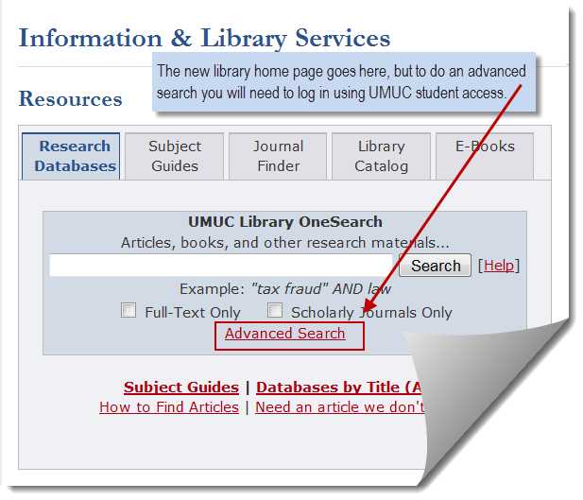
FIRST STEP: The UMUC Library
Start by accessing the UMUC library. URL: www.umuc.edu/library
An advanced search will require students to log in using UMUC user name and a password.
This can be done by the student, but for my project, I chose to take advantage of the services provided – I met with a UMUC librarian at McKeldin Library.
We’re now ready to think of a topic.

Slide 4
Topic Ideas: Maryland history, Calvert Family
Discussion with UMUC librarian helped narrow topic to the Calvert Family of Maryland.
Choose “Subject Guides” and then from the subject list choose “History.”
I chose to look for primary sources; the librarian suggested looking at a “trial” database: U.S. History in Context. A rollover on the various databases tells you what can be found in them. U.S. History in Context contains topics from pre-colonial times to present day including journal articles, primary sources and documents.

Slide 5
Search reveals 5 items – all secondary sources

Slide 6
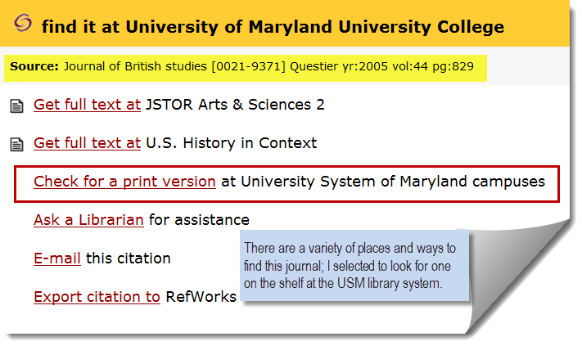
Academic journal availability
Click on “Find It” to see where the journal can be found.
It is available from a number of sources, including a print version at the USM libraries
After checking, it is available as a non-circulating reference journal at McKeldin Library

Slide 7
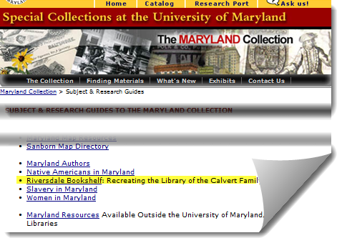
Another search at the University of Maryland Library (Special Collection)
The University of Maryland has a Maryland Room as one of their special collections.
The “Riversdale Bookshelf” contains documents, books and journals about the Calvert Family. Note: Riversdale was the home of the Calvert Family.

Slide 8
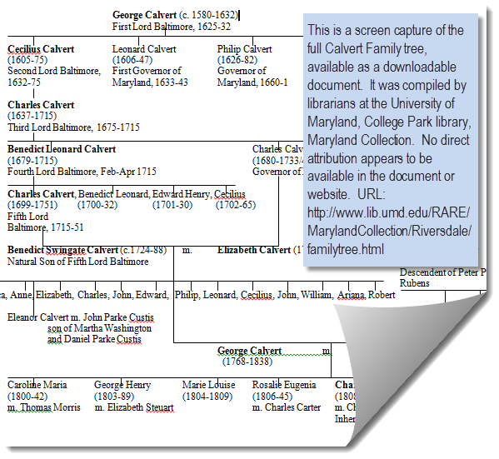
Riversdale Bookshelf – in Special Collections
An interesting secondary document was a family tree of the Calvert Family compiled by the Maryland history library staff at UMCP.
While the compiled family tree is a secondary source, it appears to have been compiled using primary sources. See box to the right for a list of the sources consulted.
NOTE INCLUDED ON FAMILY TREE ENDNOTES: We consulted three histories for information on Calvert family genealogy: Margaret Law Calcott, Mistress of Riversdale: The Plantation Letters of Rosalie Stier Calvert, 1795-1821 (Baltimore: Johns Hopkins, 1991); John Bailey Nicklin “The Calvert Family,” in Effie Gwyn Bowie, Across the Years in Prince George's County: A Genealogical and Biographical History of Some Prince George's County, Maryland and Allied Families (Richmond: Garrett and Massie, 1947); and Anne E. Yentsch, A Chesapeake Family and Their Slaves: A Study in Historical Archaeology (Cambridge: Cambridge University Press, 1994). This document is available at: http://www.lib.umd.edu/RARE/MarylandCollection/Riversdale/familytree.html

Slide 9
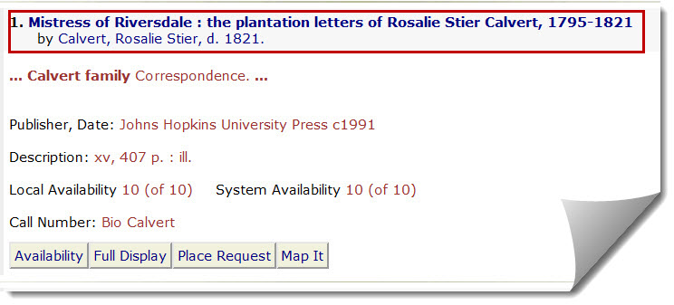
Search of the library catalog
Another search of the UMUC library catalog for “Calvert Mansion” (put in quotes to look for those words together) shows two holdings in the Maryland Room (related to Maryland Collection).
This leads to an idea about another library to use!

Slide 10
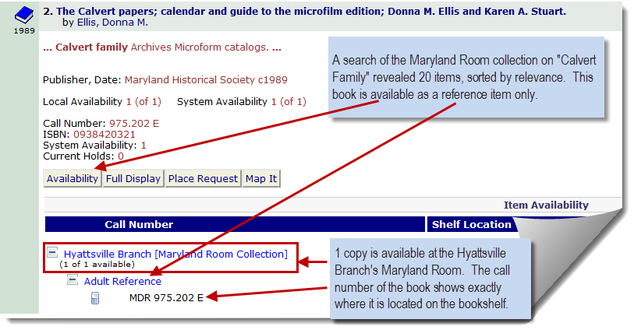
A visit to the public library is always an option!
The local public library has a Maryland Room as well, and has different types of materials from the academic libraries. Most are for reference use only.

Slide 11
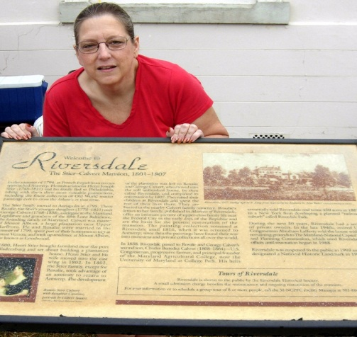
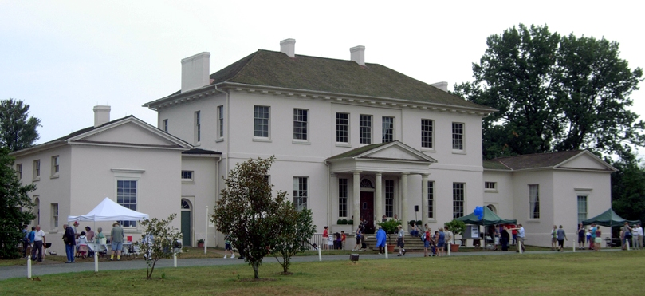
To really get a true flavor . . . visit in person!

Slide 12
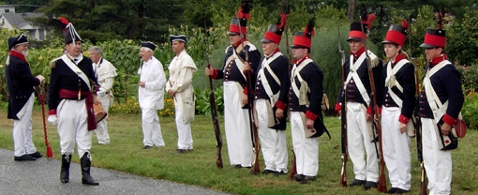
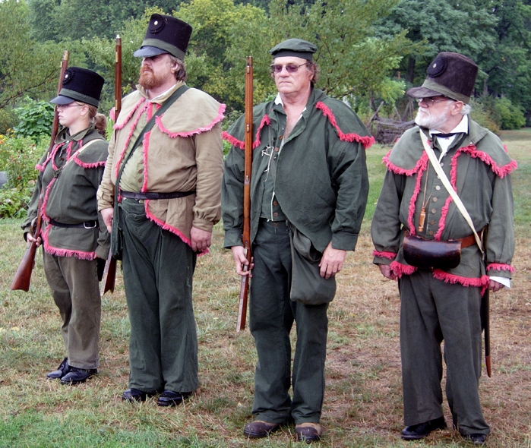
A special event at Riversdale when local historians re-enacted a typical wartime setting

Slide 13
But was I really there?
Sure was! Even took pictures with some Revolutionary War soldiers!

Slide 14
This assignment was great!
While I did not have to actually write the paper (oh, darn!), I believe this assignment put me well on my way to becoming an information literate student – ready to take on the challenges of graduate research using a variety of libraries and sources.
Using Standard One, Performance Indicator 2, through this assignment I:
Know how information is formally and informally produced, organized and disseminated
Collections, such as Riversdale Bookshelf, Maryland Room, documents created by historical librarians, and re-enactments of historical events are all learning tools for this topic
Recognize information can be organized into disciplines that influence the way information is accessed
Art and Design, Biotechnology, Distance Education, History, Linguistics
See the value and differences of resources in a variety of formats
Books, historical dictionaries, archived material, audio recordings, first-person visits
Identify popular vs. scholarly and current vs. historical sources
Most of my research materials were scholarly and historical, but the war re-enactment was done in current times but used historical uniforms, props, and training. The Calvert family tree was done in recent years, but relied on historical documents for accuracy. Visiting the public library, typically considered a “popular source” and “current source,” provided additional insight into the Calvert family.
Understand difference between primary and secondary sources
Although a historical subject, most of my resources were secondary, but some were primary. Especially in history, some documents can be classified as either/or when it comes to primary vs. secondary sources.
Know information may be constructed with raw data from primary sources
The Calvert family tree was compiled using original data from family histories, family Bibles, and other primary sources.

